Slide 1
THE LIFE OF CHRIST
PART 27

Slide 2
Matthew 6:1 "Take heed that you do not do your charitable deeds before men, to be seen by them. Otherwise you have no reward from your Father in heaven.

Slide 3
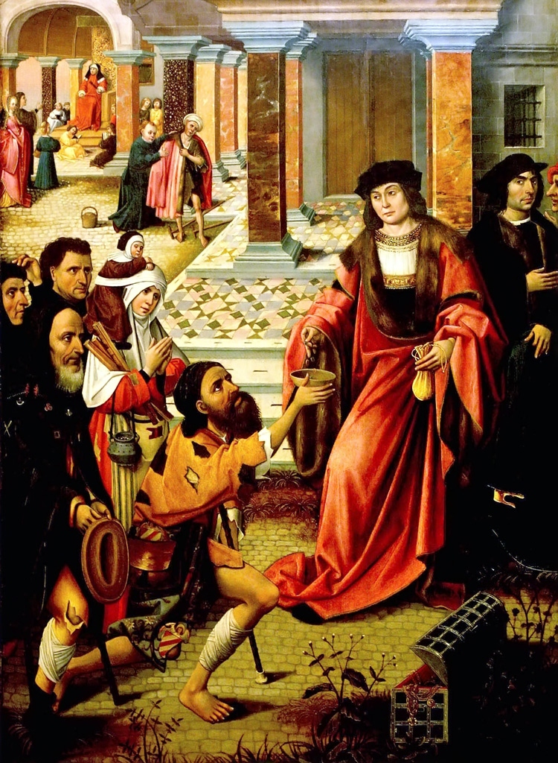

Slide 4
Matthew 23:3 "Therefore whatever they tell you to observe, that observe and do, but do not do according to their works; for they say, and do not do. ⁴ "For they bind heavy burdens, hard to bear, and lay them on men's shoulders; but they themselves will not move them with one of their fingers. ⁵ "But all their works they do to be seen by men. They make their phylacteries broad and enlarge the borders of their garments. ⁶ "They love the best places at feasts, the best seats in the synagogues, ⁷ "greetings in the marketplaces, and to be called by men, 'Rabbi, Rabbi.'

Slide 5
Matthew 5:16 "Let your light so shine before men, that they may see your good works and glorify your Father in heaven.

Slide 6
Hebrews 6:10 For God is not unjust to forget your work and labor of love which you have shown toward His name, in that you have ministered to the saints, and do minister.

Slide 7
Matthew 6:2 "Therefore, when you do a charitable deed, do not sound a trumpet before you as the hypocrites do in the synagogues and in the streets, that they may have glory from men. Assuredly, I say to you, they have their reward.

Slide 8
Matthew 6:3 "But when you do a charitable deed, do not let your left hand know what your right hand is doing, ⁴ "that your charitable deed may be in secret; and your Father who sees in secret will Himself reward you openly.

Slide 9
2 Thessalonians 1:3 We are bound to thank God always for you, brethren, as it is fitting, because your faith grows exceedingly, and the love of every one of you all abounds toward each other, ⁴ so that we ourselves boast of you among the churches of God for your patience and faith in all your persecutions and tribulations that you endure,

Slide 10
Luke 21:1 And He looked up and saw the rich putting their gifts into the treasury, ² and He saw also a certain poor widow putting in two mites. ³ So He said, "Truly I say to you that this poor widow has put in more than all; ⁴ "for all these out of their abundance have put in offerings for God, but she out of her poverty put in all the livelihood that she had."

Slide 11
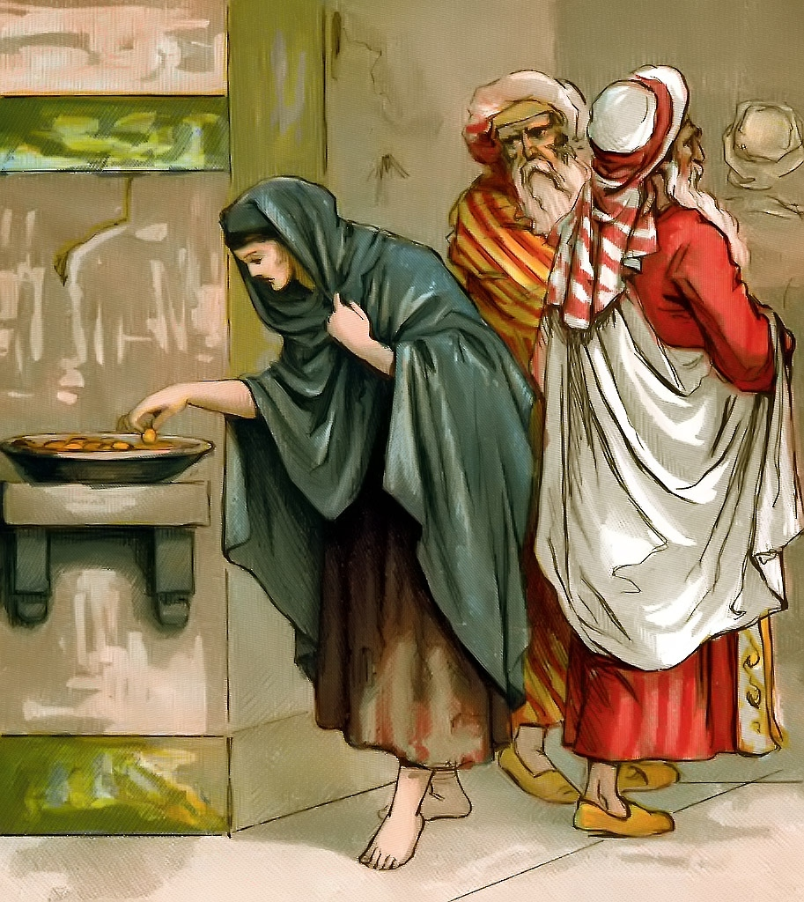

Slide 12
Matthew 6:5 " And when you pray, you shall not be like the hypocrites. For they love to pray standing in the synagogues and on the corners of the streets, that they may be seen by men. Assuredly, I say to you, they have their reward. ⁶ "But you, when you pray, go into your room, and when you have shut your door, pray to your Father who is in the secret place; and your Father who sees in secret will reward you openly.

Slide 13
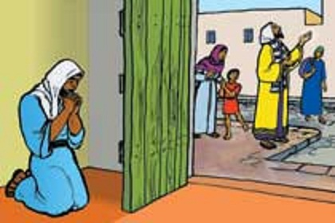

Slide 14
Matthew 6:7 "And when you pray, do not use vain repetitions as the heathen do. For they think that they will be heard for their many words. ⁸ "Therefore do not be like them. For your Father knows the things you have need of before you ask Him.

Slide 15
Vain repetitions: to repeat the same things over and over, to use many idle words, to babble, prate. Some suppose the word derived from Battus, a king of Cyrene, who is said to have stuttered; others from Battus, an author of tedious and wordy poems. (Thayer)

Slide 16
1 Kings 18:26 So they took the bull which was given them, and they prepared it, and called on the name of Baal from morning even till noon, saying, "O Baal, hear us!" But there was no voice; no one answered. Then they leaped about the altar which they had made.

Slide 17
Acts 19:34 But when they found out that he was a Jew, all with one voice cried out for about two hours, "Great is Diana of the Ephesians!"

Slide 18
Matthew 6:9 "In this manner, therefore, pray: Our Father in heaven, Hallowed be Your name. ¹⁰ Your kingdom come. Your will be done On earth as it is in heaven. ¹¹ Give us this day our daily bread. ¹² And forgive us our debts, As we forgive our debtors. ¹³ And do not lead us into temptation, But deliver us from the evil one. For Yours is the kingdom and the power and the glory forever. Amen. ¹⁴ "For if you forgive men their trespasses, your heavenly Father will also forgive you. ¹⁵ "But if you do not forgive men their trespasses, neither will your Father forgive your trespasses.

Slide 19
1 Corinthians 10:13 No temptation has overtaken you except such as is common to man; but God is faithful, who will not allow you to be tempted beyond what you are able, but with the temptation will also make the way of escape, that you may be able to bear it.

Slide 20
James 1:13 Let no one say when he is tempted, "I am tempted by God"; for God cannot be tempted by evil, nor does He Himself tempt anyone. ¹⁴ But each one is tempted when he is drawn away by his own desires and enticed. ¹⁵ Then, when desire has conceived, it gives birth to sin; and sin, when it is full-grown, brings forth death.

Slide 21
For Yours is the kingdom and the power and the glory forever. Amen.

Slide 22
¹⁴ "For if you forgive men their trespasses, your heavenly Father will also forgive you. ¹⁵ "But if you do not forgive men their trespasses, neither will your Father forgive your trespasses.

Slide 23
Luke 17:3"Take heed to yourselves. If your brother sins against you, rebuke him; and if he repents, forgive him. ⁴ "And if he sins against you seven times in a day, and seven times in a day returns to you, saying, 'I repent,' you shall forgive him." ⁵ And the apostles said to the Lord, "Increase our faith."

Slide 24
Matthew 6:16 " Moreover, when you fast, do not be like the hypocrites, with a sad countenance. For they disfigure their faces that they may appear to men to be fasting. Assuredly, I say to you, they have their reward. ¹⁷ "But you, when you fast, anoint your head and wash your face, ¹⁸ "so that you do not appear to men to be fasting, but to your Father who is in the secret place; and your Father who sees in secret will reward you openly.

Slide 25
Luke 18:10 "Two men went up to the temple to pray, one a Pharisee and the other a tax collector. ¹¹ "The Pharisee stood and prayed thus with himself, 'God, I thank You that I am not like other men -- extortioners, unjust, adulterers, or even as this tax collector. ¹² 'I fast twice a week; I give tithes of all that I possess.'

Slide 26
For the Christian, fasting is voluntary, and even for the Old Testament Jews, it was voluntary with the exception of the Day of Atonement (Lev. 16:29; Num. 29:7).

Slide 27
2 Samuel 12:16 David therefore pleaded with God for the child, and David fasted and went in and lay all night on the ground. ¹⁷ So the elders of his house arose and went to him, to raise him up from the ground. But he would not, nor did he eat food with them. ¹⁸ Then on the seventh day it came to pass that the child died. And the servants of David were afraid to tell him that the child was dead. For they said, "Indeed, while the child was alive, we spoke to him, and he would not heed our voice. How can we tell him that the child is dead? He may do some harm!"

Slide 28
¹⁹ When David saw that his servants were whispering, David perceived that the child was dead. Therefore David said to his servants, "Is the child dead?" And they said, "He is dead." ²⁰ So David arose from the ground, washed and anointed himself, and changed his clothes; and he went into the house of the LORD and worshiped. Then he went to his own house; and when he requested, they set food before him, and he ate. ²¹ Then his servants said to him, "What is this that you have done? You fasted and wept for the child while he was alive, but when the child died, you arose and ate food."

Slide 29
²² And he said, "While the child was alive, I fasted and wept; for I said, 'Who can tell whether the LORD will be gracious to me, that the child may live?' ²³ "But now he is dead; why should I fast? Can I bring him back again? I shall go to him, but he shall not return to me."

Slide 30
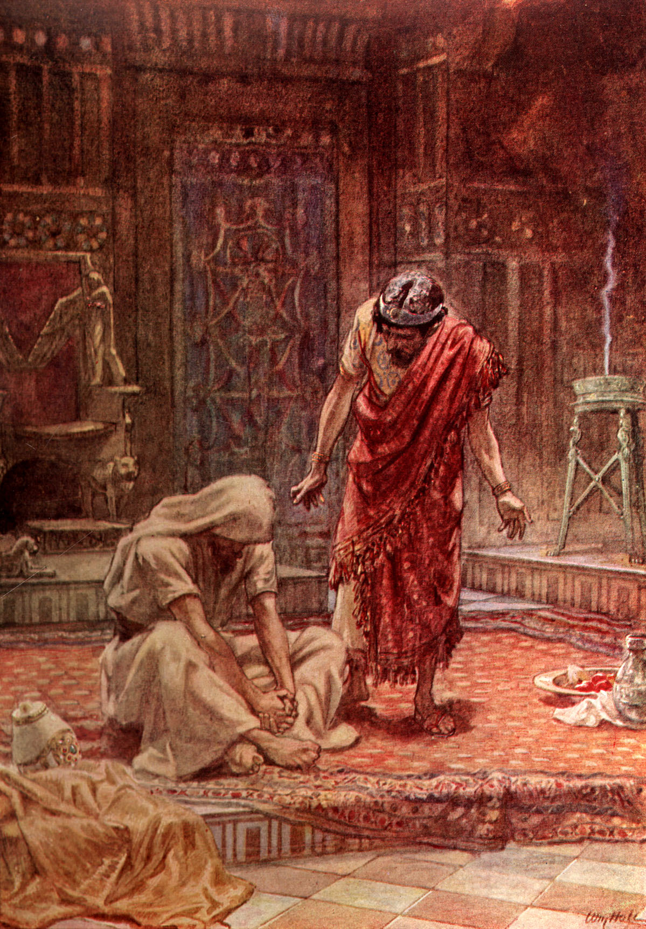

Slide 31
1 Samuel 31:11 Now when the inhabitants of Jabesh Gilead heard what the Philistines had done to Saul, ¹² all the valiant men arose and traveled all night, and took the body of Saul and the bodies of his sons from the wall of Beth Shan; and they came to Jabesh and burned them there. ¹³ Then they took their bones and buried them under the tamarisk tree at Jabesh, and fasted seven days.

Slide 32
Ezra 9:5 At the evening sacrifice I arose from my fasting; and having torn my garment and my robe, I fell on my knees and spread out my hands to the LORD my God.

Slide 33
Mark 2:18 The disciples of John and of the Pharisees were fasting. Then they came and said to Him, "Why do the disciples of John and of the Pharisees fast, but Your disciples do not fast?" ¹⁹ And Jesus said to them, "Can the friends of the bridegroom fast while the bridegroom is with them? As long as they have the bridegroom with them they cannot fast. ²⁰ "But the days will come when the bridegroom will be taken away from them, and then they will fast in those days.

Slide 34
Nehemiah did this in response to hearing about the condition of his people in Jerusalem (Neh. 1).
Cornelius was a devout man who also fasted and prayed to God (Acts 10:30).
As Saul waited in Damascus to learn what he was supposed to do to be saved, he fasted and prayed for 3 days (Acts 9:9).
The church at Antioch fasted and prayed before they sent out Paul and Barnabas on their first missionary journey (Acts 13:1-3).

